Slide 1
MONITORING WITH NAGIOS
Prsented by
Ch.Sai Poojitha
K.Jyothi

Slide 2
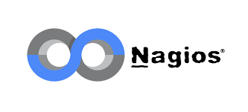
What is Nagios?
Nagios is an open-source continuous monitoring tool that monitors networks, applications, and servers. It can find and repair problems detected in the infrastructure, and stop future issues before they affect the end users. It gives the complete status of your IT infrastructure and its performance.
It was designed to run on the Linux operating system and can monitor devices running Linux, Windows and Unix operating systems (OSes).Nagios software runs periodic checks on critical parameters of application, network and server resources. Nagios also can monitor services, such as Secure Shell(SSH), Hypertext Transfer Protocol (HTTP) and other common network protocols.

Slide 3
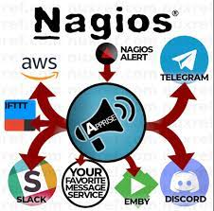
Nagios Architecture
The following points are worth notable about Nagios architecture −
Nagios has server-agent architecture.
Nagios server is installed on the host and plugins are installed on the remote hosts/servers which are to be monitored.
Nagios sends a signal through a process scheduler to run the plugins on the local/remote hosts/servers.
Plugins collect the data (CPU usage, memory usage etc.) and sends it back to the scheduler.
Then the process schedules send the notifications to the admins and updates Nagios GUI.

Slide 4
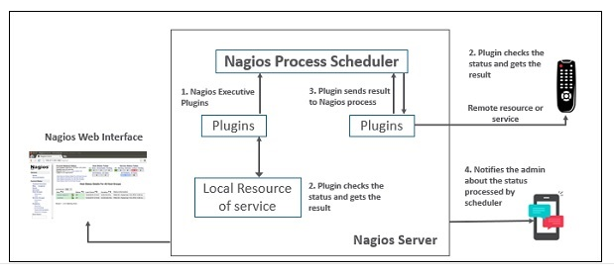
Nagios Architecture

Slide 5
It helps in getting rid of periodic testing.
Benefits of Nagios
It reduces maintenance costs without sacrificing performance.
It detects split-second failures when the wrist strap is still in the “intermittent” stage.
It detects all server and network problems and helps in troubleshooting the performance issues.

Slide 6

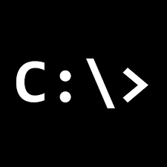

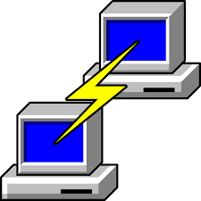
Tools Used
Nagios
Cmd
Winscp
Putty
Mobaxtrem

Slide 7




Applications
Monitor host resources such as disk space, system logs, etc.
Monitor network resources – HTTP, FTP, SMTP, SSH, etc.
Monitor log files continuously to identify infra-issue.
Monitor windows or linux or unix or web applications and their state.
Send alerts/notifications via email, sms, pager of any issue on infrastructure

Slide 8
Project and its Outcome
Initially we have installed an EC2 instance and installed Nagios in it.
Then we have modified the configuration files of nagios such as nagios.cfg file, localhost.cfg file.
Now we added some of the ip addresses to monitor the network usage, amount of hard disk used and also number of users connected as well as the ping statistics.
To the extension of our project we have also monitored Codemind platform and observed its stats.
We have done this process on both command line interface and graphical user interface.
In addition to this we want to integrate AWS Cloud watch to send alerts when there are some threats to the servers so that we can quickly resolve the issues raised.
This leads to continuous monitoring of any kind of platform or an application at any phase of the devops lifecycle which helps to reduce the costs of infrastructure and also optimizing the performance.
It also supports to visualize the condition of the server graphically by using histograms and it also supports to customize the settings of the histograms such as monitoring daily or weekly or monthly etc.. and also produces summary of this report.
This is the IP address –54.167.16.85/nagios/ on which we have monitered the codemind platform.

Slide 9
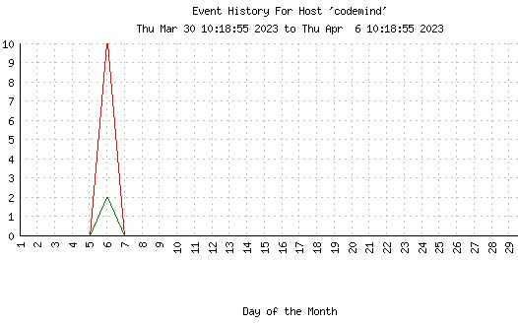
The Conclusion…
This graph shows the statistics of the Codemind application.
We can also observe that active state (green lines) of the application and also
inactive state (red lines) which shows the down state of the application.
Intellectuals solve problems
Geniuses prevents them.

